Slide 1
Constructive Computer Architecture:
RISC-V Instruction Set Architecture (ISA)
Arvind
Computer Science & Artificial Intelligence Lab.
Massachusetts Institute of Technology

Slide 2
ISA: The software interface of programmable machine
Software tools
assembler compilers interpreters OS, ...
ISA
non-pipelined pipelined OOO ...
Micro-architectures
Instruction set architecture is a set of instructions
Each instruction defines a way to transform the machine state
ISA is a contract that an architect must follow while designing a machine a for a specific Performance, Power and Area (PPA) objective

Slide 3
RISC-V
A new, open, free ISA from Berkeley
Several variants
RV32, RV64, RV128 – Different data widths
‘I’ – Base Integer instructions
‘M’ – Multiply and Divide
‘A’ – Atomic memory instructions
‘F’ and ‘D’ – Single and Double precision floating point
‘V’ – Vector extension
And many other modular extensions
We will design an RV32I processor which is the base 32-bit variant

Slide 4
RV32I Register State
32 general purpose registers (GPR)
x0, x1, …, x31
32-bit wide integer registers
x0 is hard-wired to zero
Program counter (PC)
32-bit wide
CSR (Control and Status Registers)
User-mode
cycle (clock cycles) // read only
instret (instruction counts) // read only
Machine-mode
hartid (hardware thread ID) // read only
mepc, mcause etc. used for exception handling
Custom
mtohost (output to host) // write only – custom extension
Memory

Slide 5
Instruction Types
Register-to-Register Arithmetic and Logical operations
Control Instructions alter the sequential control flow
Memory Instructions move data to and from memory
CSR Instructions move data between CSRs and GPRs; the instructions often perform read-modify-write operations on CSRs
Privileged Instructions are needed by the operating systems, and most cannot be executed by user programs

Slide 6
Instruction Formats
R-type instruction
source reg
destination reg
7
5
5
3
5
7
funct7
rs2
rs1
funct3
rd
opcode
I-type instruction & I-immediate (32 bits)
12
5
3
5
7
imm[11:0]
rs1
funct3
rd
opcode
I-imm = signExtend(inst[31:20])
S-type instruction & S-immediate (32 bits)
7
5
5
3
5
7
imm[11:5]
rs2
rs1
funct3
imm[4:0]
opcode
S-imm = signExtend({inst[31:25], inst[11:7]})

Slide 7
Instruction Formats cont.
Immediate constants have strange encodings!
SB-type instruction & B-immediate (32 bits)
1
6
5
5
3
4
1
7
imm[12]
imm[10:5]
rs2
rs1
funct3
imm[4:1]
imm[11]
opcode
B-imm = signExtend({inst[31], inst[7], inst[30:25], inst[11:8], 1’b0})
U-type instruction & U-immediate (32 bits)
20
5
7
imm[31:12]
rd
opcode
U-imm = signExtend({inst[31:12], 12’b0})
UJ-type instruction & J-immediate (32 bits)
1
10
1
8
5
7
imm[20]
imm[10:1]
imm[11]
imm[19:12]
rd
opcode
J-imm = signExtend({inst[31], inst[19:12], inst[20], inst[30:21], 1’b0})

Slide 8
Computational Instructions
Register-Register instructions (R-type)
opcode=OP: rd ← rs1 (funct3, funct7) rs2
funct3 = SLT/SLTU/AND/OR/XOR/SLL
funct3= ADD
funct7 = 0000000: rs1 + rs2
funct7 = 0100000: rs1 – rs2
funct3 = SRL
funct7 = 0000000: logical shift right
funct7 = 0100000: arithmetic shift right
7
5
5
3
5
7
funct7
rs2
rs1
funct3
rd
opcode

Slide 9
Computational Instructions cont
Register-immediate instructions (I-type)
opcode = OP-IMM: rd ← rs1 (funct3) I-imm
I-imm = signExtend(inst[31:20])
funct3 = ADDI/SLTI/SLTIU/ANDI/ORI/XORI
A slight variant in coding for shift instructions - SLLI / SRLI / SRAI
rd ← rs1 (funct3, inst[30]) I-imm[4:0]
12
5
3
5
7
imm[11:0]
rs1
funct3
rd
opcode
Notes:
What is the role of inst[30]?

Slide 10
Computational Instructions cont.
Register-immediate instructions (U-type)
opcode = LUI : rd ← U-imm
opcode = AUIPC : rd ← pc + U-imm
U-imm = {inst[31:12], 12’b0}
20
5
7
imm[31:12]
rd
opcode

Slide 11
Control Instructions
Unconditional jump and link (UJ-type)
opcode = JAL: rd ← pc + 4; pc ← pc + J-imm
J-imm = signExtend({inst[31], inst[19:12], inst[20], inst[30:21], 1’b0})
Jump ±1MB range
Unconditional jump via register and link (I-type)
opcode = JALR: rd ← pc + 4; pc ← (rs1 + I-imm) & ~0x01
I-imm = signExtend(inst[31:20])
1
10
1
8
5
7
imm[20]
imm[10:1]
imm[11]
imm[19:12]
rd
opcode
12
5
3
5
7
imm[11:0]
rs1
funct3
rd
opcode
Notes:
Effect of ~0x01

Slide 12
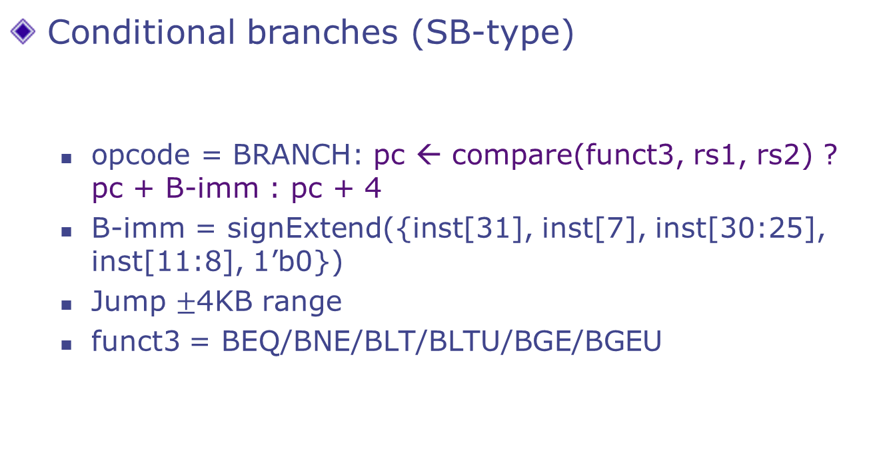
Control Instructions cont.
Conditional branches (SB-type)
opcode = BRANCH: pc ← compare(funct3, rs1, rs2) ? pc + B-imm : pc + 4
B-imm = signExtend({inst[31], inst[7], inst[30:25], inst[11:8], 1’b0})
Jump $±$4KB range
funct3 = BEQ/BNE/BLT/BLTU/BGE/BGEU
1
6
5
5
3
4
1
7
imm[12]
imm[10:5]
rs2
rs1
funct3
imm[4:1]
imm[11]
opcode

Slide 13
Load & Store Instructions
Load (I-type)
opcode = LOAD: rd ← mem[rs1 + I-imm]
I-imm = signExtend(inst[31:20])
funct3 = LW/LB/LBU/LH/LHU
Store (S-type)
opcode = STORE: mem[rs1 + S-imm] ← rs2
S-imm = signExtend({inst[31:25], inst[11:7]})
funct3 = SW/SB/SH
12
5
3
5
7
imm[11:0]
rs1
funct3
rd
opcode
7
5
5
3
5
7
imm[11:5]
rs2
rs1
funct3
imm[4:0]
opcode
Notes:
Ignore byte and half word instructions: LB, LBU, LH, LHU, SB, SH

Slide 14
Instructions to Read and Write CSR
opcode = SYSTEM
CSRW rs1, csr (funct3 = CSRRW, rd = x0): csr ← rs1
CSRR csr, rd (funct3 = CSRRS, rs1 = x0): rd ← csr
12
5
3
5
7
csr
rs1
funct3
rd
opcode
Notes:
I currently implement the 4 CSRs (cycle, instret, hartid, mtohost) in the slide.
There are many other CSRs: e.g. mstatus
We need to implement mepc and mcause when handling exceptions.
cycle, instret, hartid – read-only
mtohost – write-only
Complete instructions to access CSR: CSRRW[I], CSRRS[I], CSRRC[I]
These instructions will read-modify-write CSRs.
CSRR and CSRW are easiest cases where only read or write happens.

Slide 15
Assembly Code VS Binary
Its too tedious to write programs in binary
To simplify writing programs, assemblers provide:
mnemonics for instructions
add x1, x2, x3
pseudo instructions
mov x1, x2 // short for add x1, x2, x0
li x1, 6175 // short for lui x1, 2 ; addi x1, x1, -2017 (exact sequence depends on immediate value)
symbols for program locations and data
bnz x1, loop_begin
lw x1, flag
Assemblers translate programs into machine code for the processor to execute

Slide 16
GCD in C
// require: x >= 0 && y > 0
int gcd(int a, int b) {
int t;
while(a != 0) {
if(a >= b) {
a = a - b;
}
else {
t = a; a = b; b = t;
}
}
return b;
}

Slide 17
GCD in RISC-V Assembler
// a: x1, b: x2, t: x3
begin:
beqz x1, done // if(x1 == 0) goto done
blt x1, x2, b_bigger // if(x1 < x2) goto b_bigger
sub x1, x1, x2 // x1 := x1 - x2
j begin // goto begin
b_bigger:
mv x3, x1 // x3 := x1
mv x1, x2 // x1 := x2
mv x2, x3 // x2 := x3
j begin // goto begin
done: // now x2 contains the gcd

Slide 18
Application Binary Interface (ABI)
Specifies rules for register usage in passing arguments and results for function calls
Callee-saved registers vs Caller-saved registers
Assigns aliases for registers x1-x31
a0 to a7 – function argument registers (caller-saved)
a0 and a1 – function return value registers
s0 to s11 – Saved registers (callee-saved)
t0 to t6 – temporary registers (caller-saved)
ra – return address (caller-saved)
sp – stack pointer (callee-saved)
gp (global pointer), and tp (thread pointer) point to specific locations in memory used by the program for global and thread-local variables respectively

Slide 19
Calling GCD Using the ABI
// assume we want to do the gcd of s0 and s1
// and put the result in s2
mov a0, s0
mov a1, s1
addi sp, sp, -8 // saving registers in the stack
// as needed by the caller
sw t0, 4(sp)
sw t1, 0(sp)
jal gcd // call gcd function
lw t0, 4(sp) // restoring caller-saved registers
lw t1, 0(sp)
addi sp, sp, 8
mov s2, a0
preparing arguments in a0, a1, etc.
temporary

Slide 20
GCD in RISC-V Assembler Using the ABI
// a: x1, b: x2, t: x3
begin:
beqz x1, done
blt x1, x2, b_bigger
sub x1, x1, x2
j begin
b_bigger:
mv x3, x1
mv x1, x2
mv x2, x3
j begin
done:
// a: a0, b: a1, t: t0
gcd:
beqz a0, done
blt a0, a1, b_bigger
sub a0, a0, a1
j gcd
b_bigger:
mv t0, a0
mv a0, a1
mv a1, t0
j gcd
done: // now a1 contains the gcd
mv a0, a1 // move to a0 for returning
ret // jr ra
argument
temporary
ABI dictates that the result must come back in a0

Slide 21
Multiply
mul x1, x2, x3 is an instruction in the ‘M’ extension (x1 := x2 * x3)
If ‘M’ is not implemented, this is an illegal instruction
What happens if we run code from an RV32IM machine on an RV32I machine?
mul causes an illegal instruction exception
An exception handler can take over and abort the program or emulate the instruction

Slide 22
Exception handling
When an exception is caused
Hardware saves the information about the exception in CSRs:
mepc – exception PC
mcause – cause of the exception
mstatus.mpp – privilege mode of exception
Processor jumps to the address of the trap handler (stored in the mtvec CSR) and increases the privilege level
An exception handler, a software program, takes over and performs the necessary action

Slide 23
Software for interrupt handling
Hardware transfers control to the common software interrupt handler (CH) which:
Saves all GPRs into the memory pointed by mscratch
Passes mcause, mepc, stack pointer to the IH (a C function) to handle the specific interrupt
On the return from the IH, writes the return value to mepc
Loads all GPRs from the memory
Execute ERET, which does:
set pc to mepc
pop mstatus (mode, enable) stack
GPR
IH
CH
1
2
3
4
5
IH
IH

Slide 24
Common Interrupt Handler- SW
common_handler: # entry point for exception handler # get the pointer to HW-thread local stack
csrrw sp, mscratch, sp # swap sp and mscratch
# save x1, x3 ~ x31 to stack (x2 is sp, save later)
addi sp, sp, -128
sw x1, 4(sp)
sw x3, 12(sp)
...
sw x31, 124(sp)
# save original sp (now in mscratch) to stack
csrr s0, mscratch # store mscratch to s0
sw s0, 8(sp)

Slide 25
Common handler- SW cont. Setting up and calling IH_Dispacher
common_handler:
... # we have saved all GPRs to stack
# call C function to handle interrupt
csrr a0, mcause # arg 0: cause
csrr a1, mepc # arg 1: epc
mv a2, sp # arg 2: sp – pointer to all saved GPRs
jal ih_dispatcher # calls ih_dispatcher which may
# have been written in C
# return value is the PC to resume
csrw mepc, a0
# restore mscratch and all GPRs
addi s0, sp, 128; csrw mscratch, s0
lw x1, 4(sp); lw x3, 12(sp); ...; lw x31, 124(sp)
lw x2, 8(sp) # restore sp at last
mret # finish handling interrupt

Slide 26
IH Dispatcher (in C)
long ih_dispatcher(long cause, long epc, long *regs) {
// regs[i] refers to GPR xi stored in stack
if(cause == 0x02)
// illegal instruction
return illegal_ih(cause, epc, regs);
else if(cause == 0x08)
// ecall (environment-call) instruction
return syscall_ih(cause, epc, regs);
else ... // other causes
}
Notes:
Reg 26 and 27 are temporary registers available to the kernel (specified by Application Binary Interface (ABI))

Slide 27
SW emulation of MULT instruction
mul rd, rs1, rs2
With proper exception handlers we can implement unsupported instructions in SW
MUL returns the low 32-bit result of rs1*rs2 into rd
MUL is decoded as an unsupported instruction and will throw an Illegal Instruction exception
SW handles the exception in illegal_inst_ih() function
illegal_inst_ih() checks the opcode and function code of MUL to call the emulated multiply function
Control is resumed to epc + 4 after emulation is done (ERET)

Slide 28
Illegal Instruction IH (in C)
long illegal_inst_ih(long cause, long epc, long *regs)
{ uint32_t inst = *((uint32_t*)epc); // fetch inst
// check opcode & function codes
if((inst & MASK_MUL) == MATCH_MUL) {
// is MUL, extract rd, rs1, rs2 fields
int rd = (inst >> 7) & 0x01F;
int rs1 = ...; int rs2 = ...;
// emulate regs[rd] = regs[rs1] * regs[rs2]
emulate_multiply(rd, rs1, rs2, regs);
return epc + 4; // done, resume at epc+4
} else abort();
}

